Slide 1
Project Update 2
Grant Hanley, RJ Cubarrubia, Matt Scheffel, Abigail Snyder

Slide 2
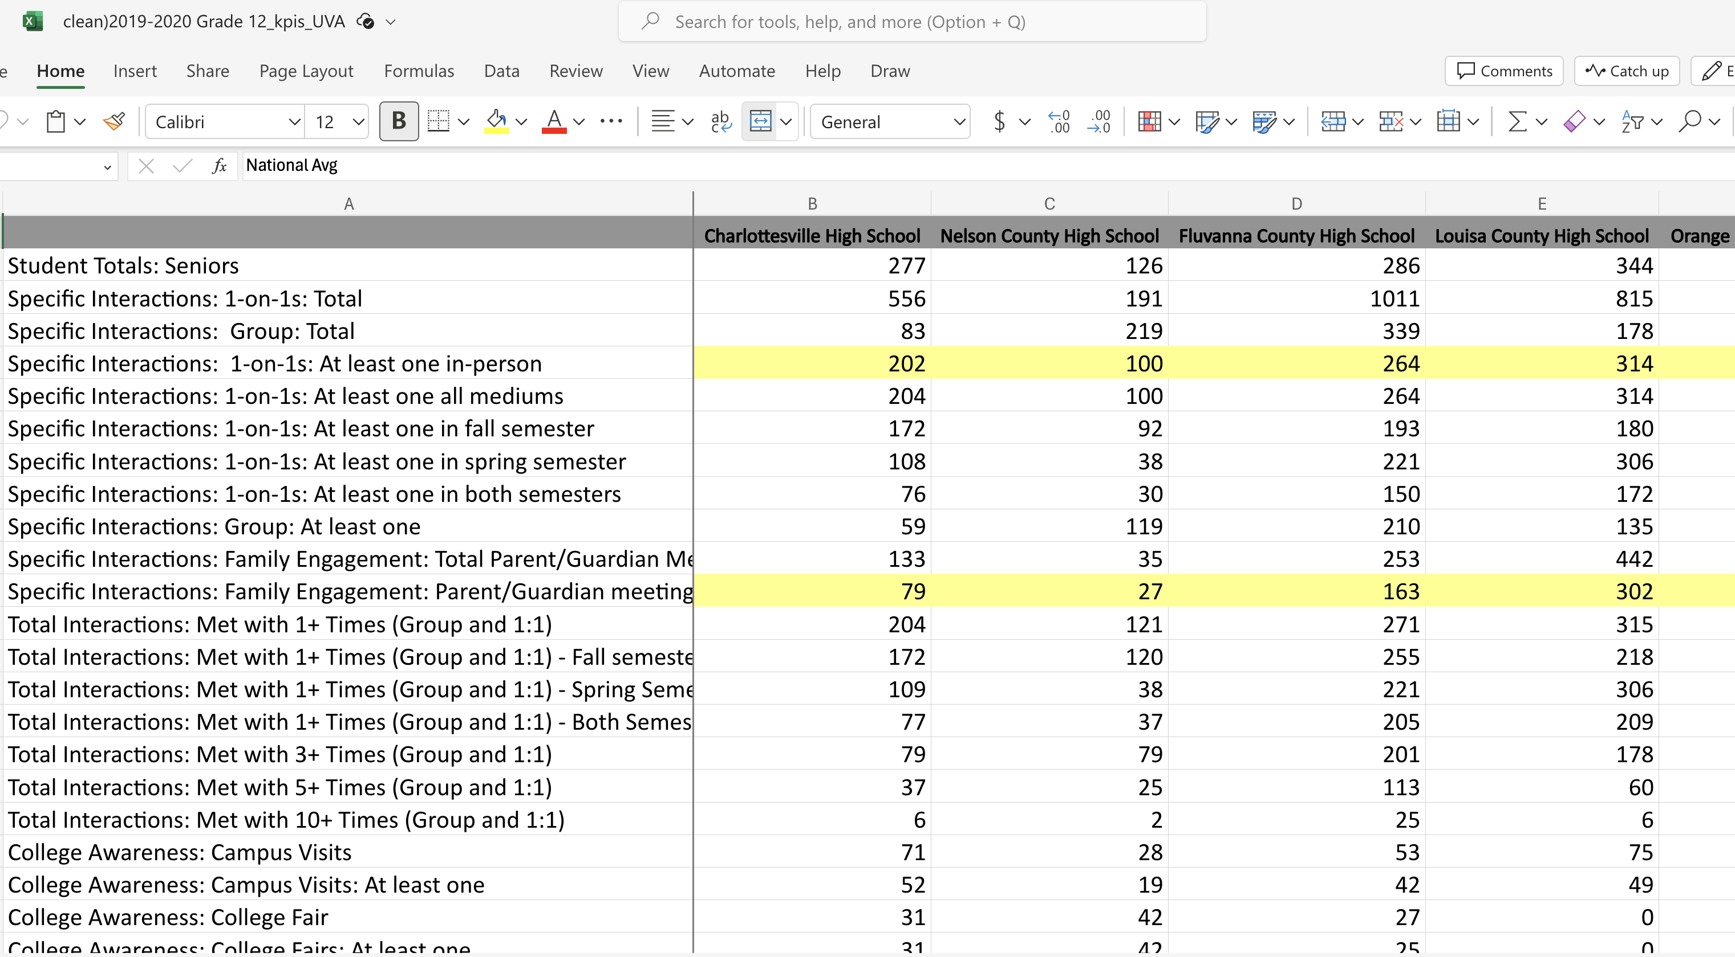
KPI Initial Data Cleaning
We worked together as a team under Grant's guidance to systematically clean and "match" the separate .xlsx files containing the KPI data from each year.
This started with manually working in each file to align variable names and check for school names.

Slide 3
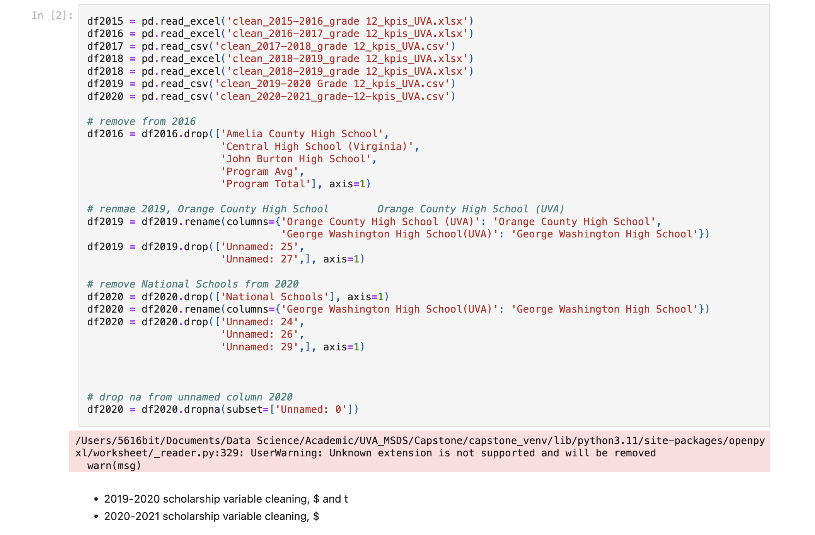
KPI Data Pre-Processing
Then, Grant created a notebook to import and pre-process the data.
He imported each Excel file, checked that each file had the same column and variable names, imputed missing variables as needed, updated several school names that had changed over time so that they aligned across all years, and pivoted the dataframe.

Slide 4
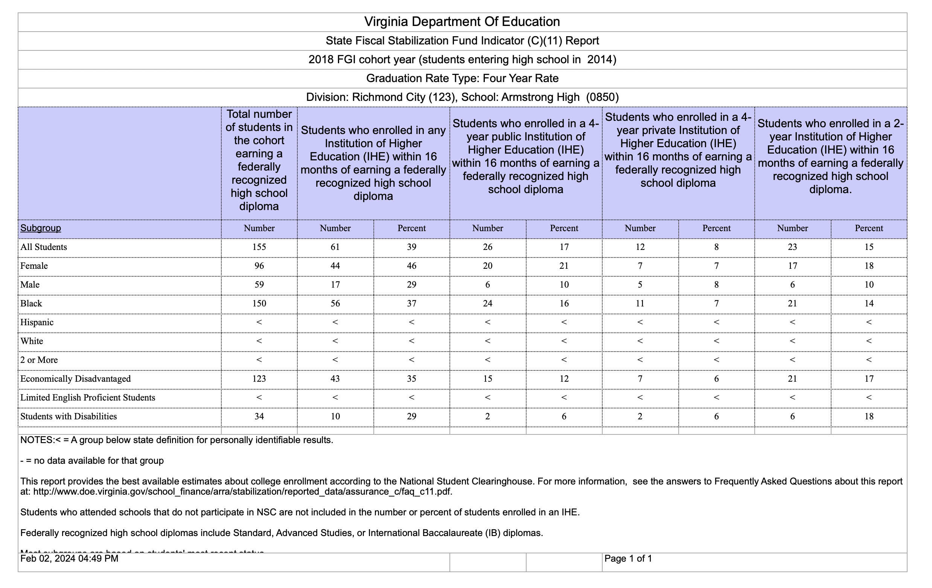
Enrollment Data Pre-Processing
The second set of data was enrollment data gathered from the Virginia Department of Education, which was also in separate .csv files for each school and each year.
Again, we worked together to clean this data, starting with the individual .csv files, then adding to the notebook to further process and combine this data with the KPI data.

Slide 5
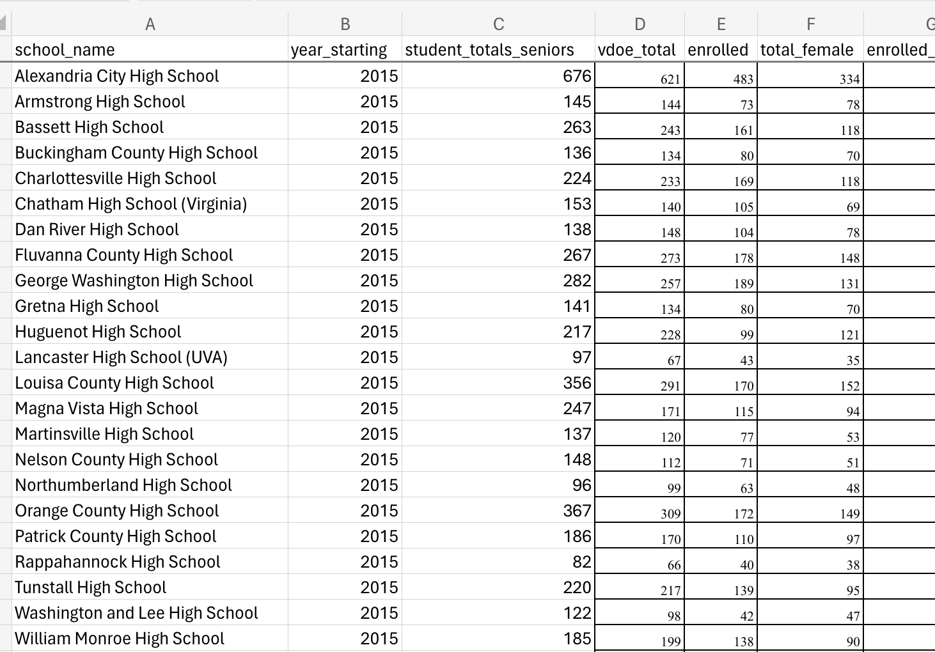
VDOE Data Pre-Processing
Due to the varied nature of the VDOE data files, we were required to manually enter data from each individual school and year into a collective CSV.

Slide 6
Research Questions
The questions asked by the VCAC guided our exploratory data analysis after merging the VDOE and the VCAC KPI data.
What is the effect on 2- and 4-year postsecondary enrollment rates with the intervention of a VCAC college adviser?
Are there significant effects on sub-populations including these categories tracked by VDOE: Female, Male, Black, Hispanic, White, 2 or More Races, Economically Disadvantaged, Students with Disabilities?
What is the relationship between certain college adviser activities (as measured by KPI output data) and postsecondary enrollment rates at each partner high school?
Are some activities better predictors of an increase in postsecondary enrollment?

Slide 7
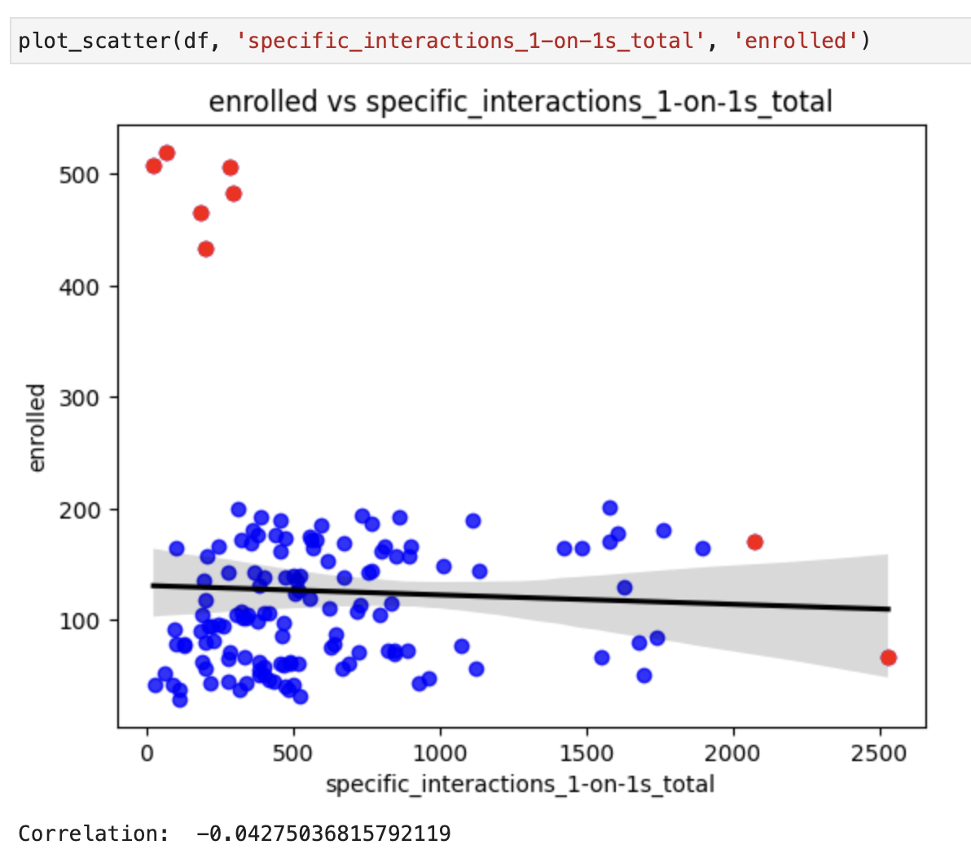
Exploratory Data Analysis
My initial goal was to see if there was any evident correlation between counselor interactions and enrollment, so I created a basic scatterplot of the two variables 'specific_interactions_1-on-1s_total' and 'enrolled.'
When looking at all schools and all years, no obvious correlation exists.

Slide 8
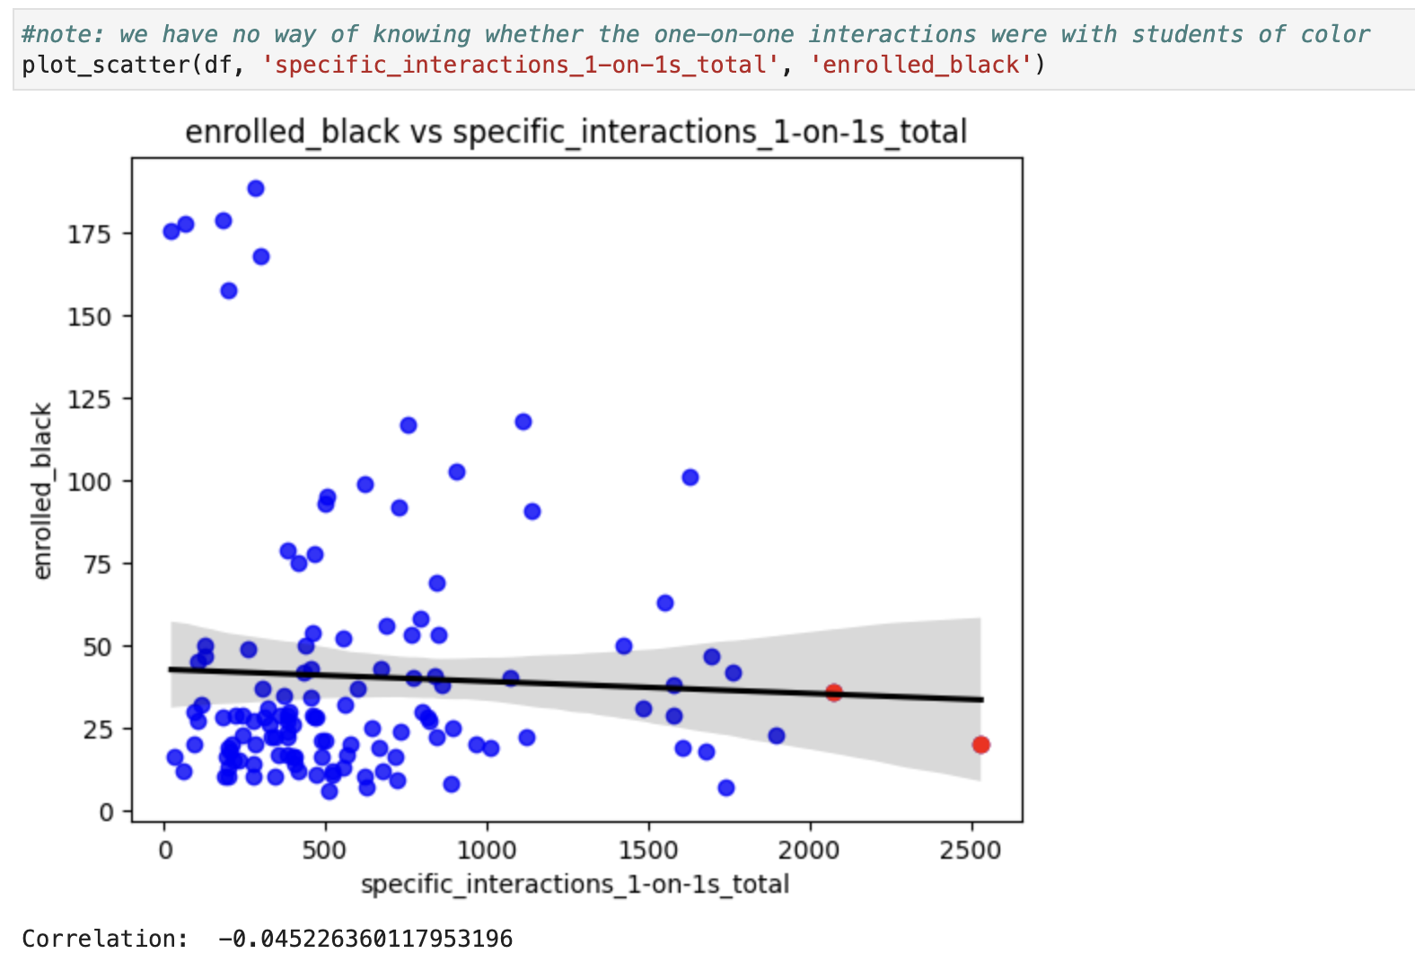
Exploratory Data Analysis
I then created follow-up scatterplots of sub-group enrollments (black, white, Asian, economically disadvantage, students with disabilities, language learners, etc.), but noted that without more specific, individual-level data, even observed correlations would only be a wild guess, as we have no way of knowing that the counselor interactions were with these sub-groups of students.

